Slide 1
Zero Dynamics Attacks and Mitigation Strategies
Mengxiang Jiang

Slide 2
AGENDA
Introduction
Nonminimum Phase Systems
Strategies
Conclusion

Slide 3
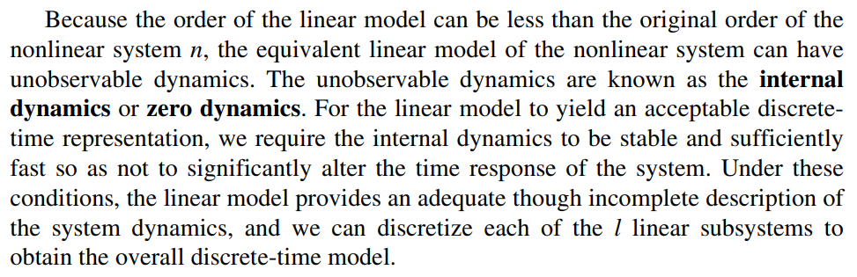
INTRODUCTION
Digital Control Engineering Analysis and Design 2nd Ed.
p. 444

Slide 4
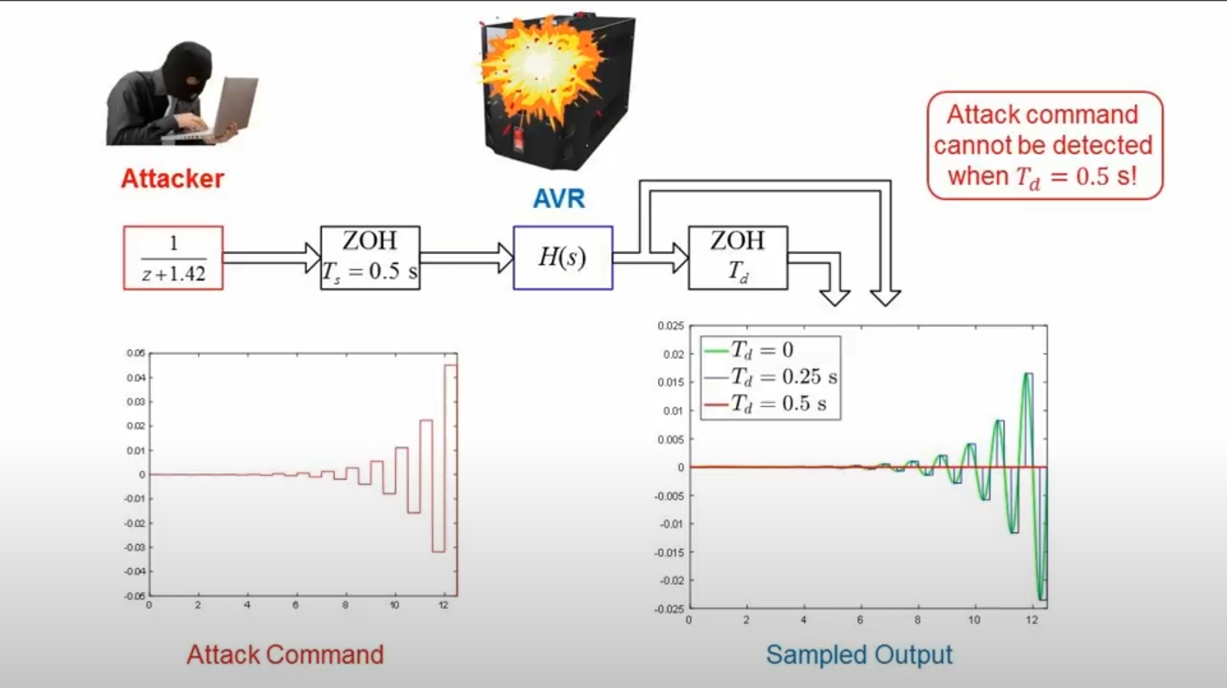
Zero Dynamics Attack Example

Slide 5
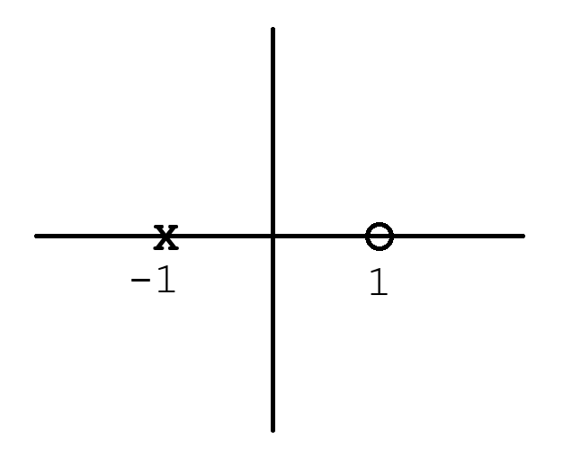
Nonminimum Phase Systems
Right Half Plane Zero
Ex. G(s) = (s-1)/(s+1)

Slide 6
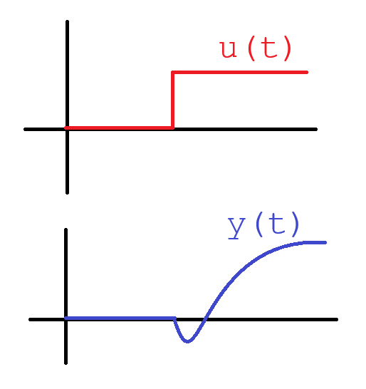
Nonminimum Phase Systems
Goes in the wrong direction first

Slide 7
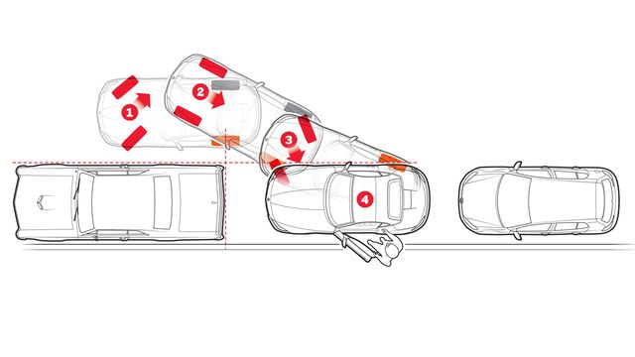
Nonminimum Phase Example: Parallel Parking

Slide 8
So Just Use Minimum Phase Systems?
Unfortunately, even if the system is minimum phase, they are often sampled data systems, and unstable sampling zeros may be introduced when the system has relative degree greater than two with a small sampling period. Nuclear power plants, smart grids, SCADA, etc. are usually high dimensional systems with large relative degree and therefore similarly vulnerable to zero dynamics attack.

Slide 9
Modify Control Strategy
The most obvious strategy to counteract a zero dynamics attack is to simply change the system’s structure such as adding an additional modulation block in front of the control input. After the modification, the zeros are shifted to new positions unknown to the attacker and therefore the old zero dynamics attack would not work.
However, if the relative degree is not changed, the attacker can still overcome the lack of model knowledge by using robust control schemes in a robust zero dynamics attack, as well as approximate the locations of the zeros.

Slide 10
Multirate Sampling Strategy
The key insight of this strategy is that even though the sampled measurements cannot detect the attack, the continuous time output may.
If the sampler measures the continuous time output more frequently than the attacker expected, the attack will be detected.

Slide 11
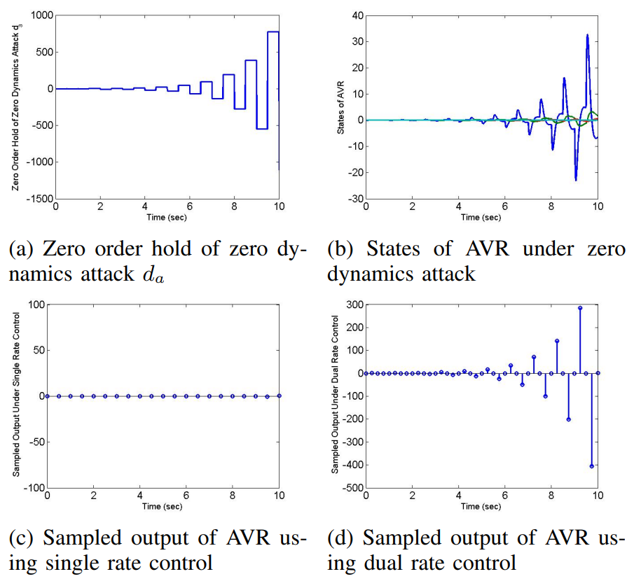
Multirate Results

Slide 12
ShortComing of the Multirate Strategy
If the attack targets intrinsic zeros with a sampling period small enough, the attack becomes practically stealthy for long enough that even if detected will have most likely caused damage.

Slide 13
Generalized Hold Strategy
Motivated by the fact that zero dynamics attacks cannot be detected in theory, instead move the zeros of the sampled data system inside the unit circle in the complex plane to make the attack less harmful.
The zero order hold (ZOH) and first order hold (FOH) are particular cases of what are called generalized hold functions (GH), and a tailored GH can be utilized.

Slide 14
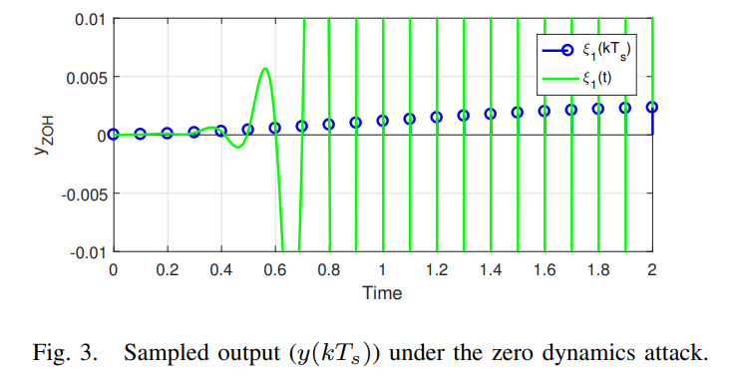
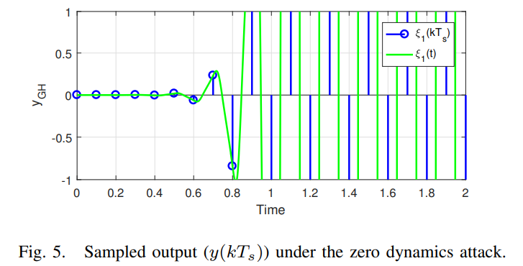
Generalized Hold Results

Slide 15
Conclusion
Zero dynamics attacks pose a significant threat to control systems in critical infrastructure, exploiting system vulnerabilities in a way that's hard to detect. Our discussion underscores the need for both detailed monitoring and thorough understanding of system dynamics for effective mitigation of these attacks.

Slide 16
REferences
M. S. Fadali and A. Visioli, Digital Control Engineering, Analysis and Design, 2nd ed. Amsterdam, The Netherlands: Elsevier, 2013.
M. Naghnaeian, N. Hirzallah, and P. G. Voulgaris, “Dual rate control for security in cyber-physical systems,” in Proc. of IEEE Conference on Decision and Control, 2015, pp. 1415–1420.
A. Hoehn and P. Zhang, “Detection of covert attacks and zero dynamics attacks in cyber-physical systems,” in Proc. of IEEE American Control Conference, 2016, pp. 302–307.
J. Back, J. Kim, C. Lee, G. Park, and H. Shim, “Enhancement of security against zero dynamics attack via generalized hold,” in Proc. IEEE 56th Annu. Conf. Decis. Control, 2017, pp. 1350–1355.

